Slide 1
Build Triggers Poll SCM
Now Jenkins will check the commit and run the pipeline.

Slide 2
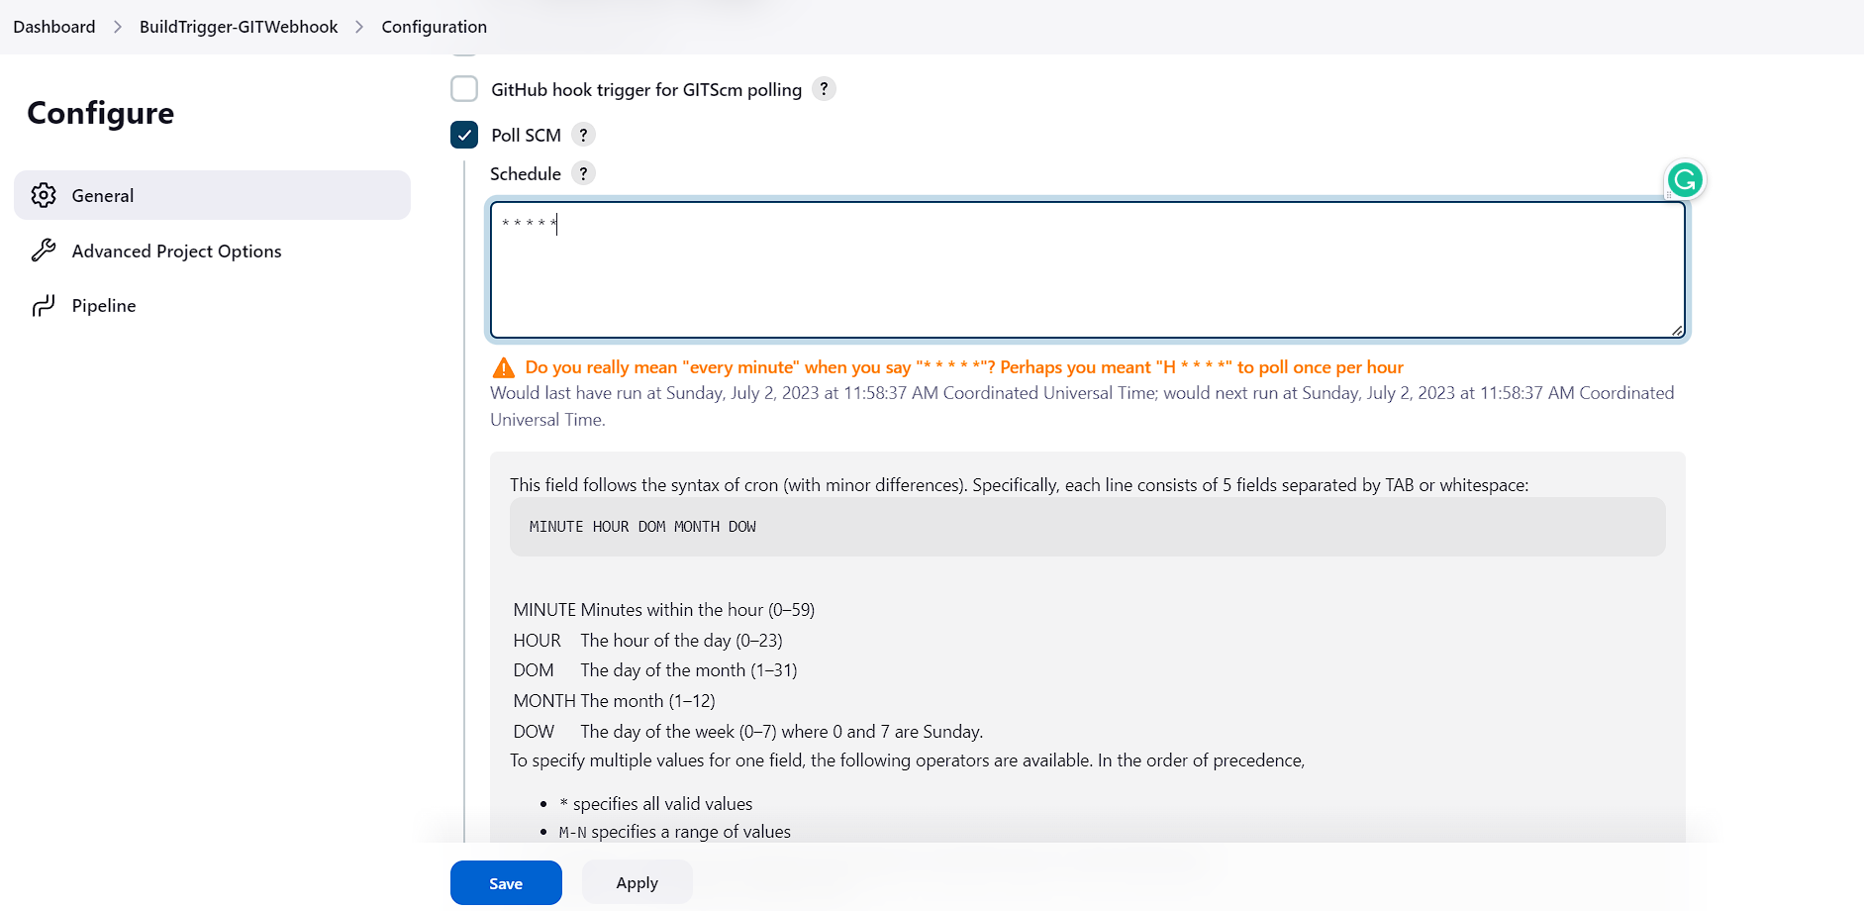

Slide 3
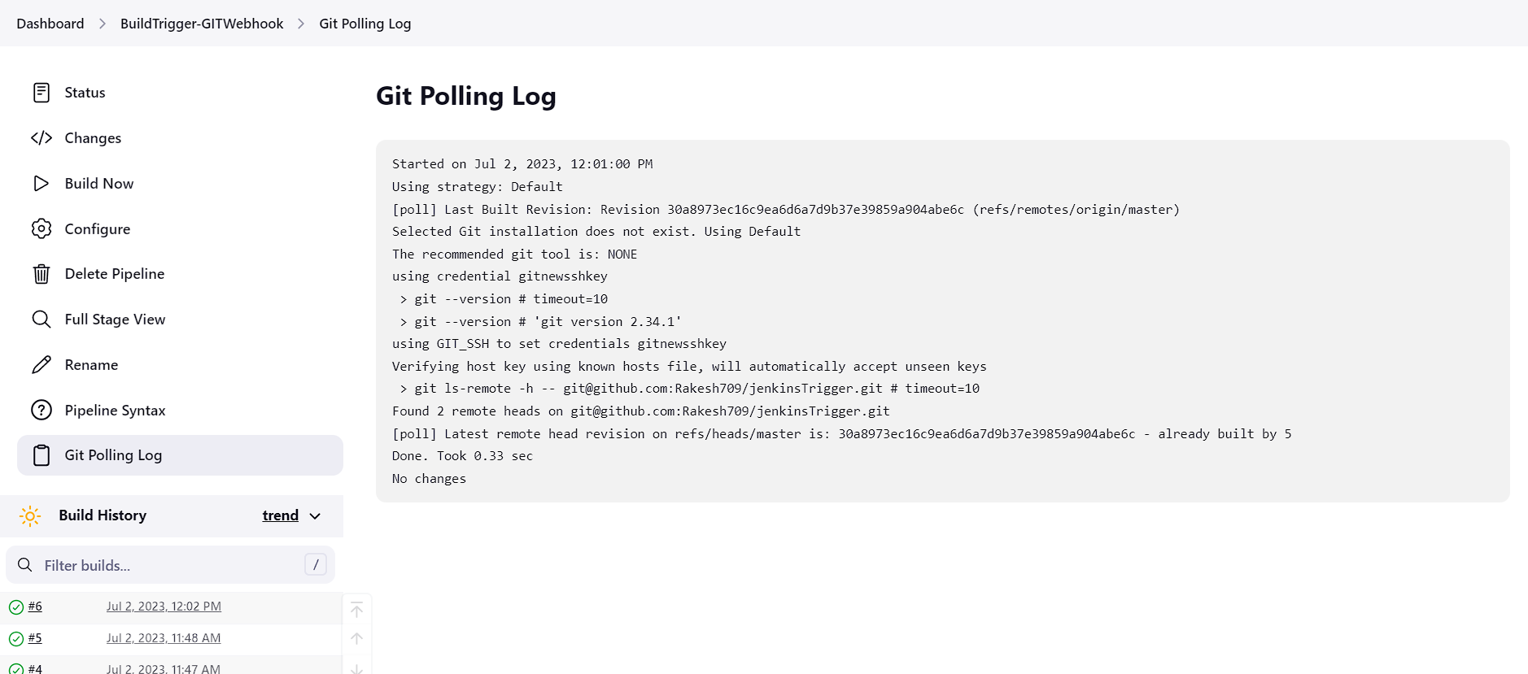
Before commit

Slide 4
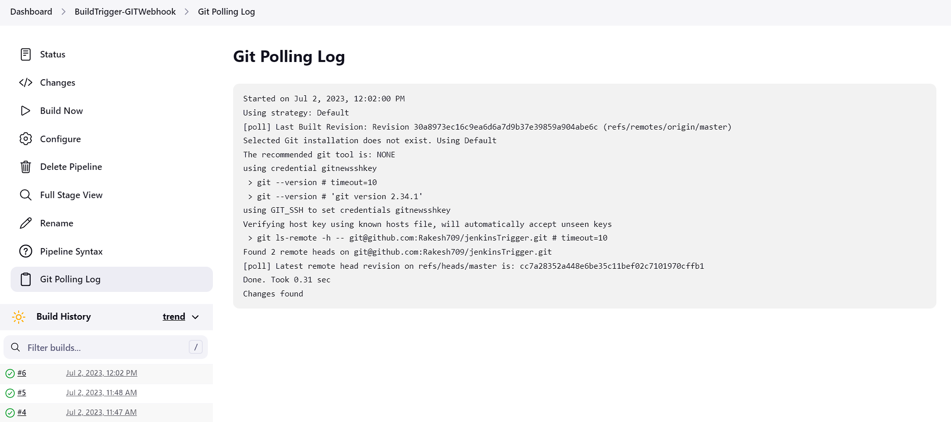
After Commit

